Slide 1
A Calvary Academics Development
Ministry Programme
New Dynamic e-Learning Course:
Certificate in Christian Discipleship
Advanced e-Learning Technology on the CAP

Slide 2

Qualities of the Programme
Down-loaded websites on DVD
Full colour pdf course material
Advanced e-learning method
A qualified personal tutor
High international standards

Slide 3
Ministry Qualifications
Five programmes are offered:
Cert. in Christian Discipleship (80 credits)
Diploma in Leadership (80 credits)
Advanced Diploma in Ministry (80 credits)
Higher Dip. in Shepherding (80 credits)
RPL Bachelor of Ministry (80 credits)
80 credits per phase – assignments, tests, tasks

Slide 4

Upon Registration
Students must have Grade 12 (St. 10) or be over 22 years old and have Grade 10
Arrange for access to a computer: at home or at the Tuition Centre
Appointed to a qualified, mature, Christian Tutor who is IT literate to guide the student through the e-learning process.

Slide 5

e-Learning technology
  The e-learning Website platform provides:
  Internet links, MP3’s, PPT’s, forum discussions, on-line tests, a grade-book, and extra articles.
  Learning material can also be viewed in colour.
  Our technology is up-to-date and will be
  further enhanced.
  The technology element is brought in, to improve
  the learning experience.

Slide 6
Equipping for Church Life
Three elements provide balance:
Topical Ministry courses x 3
MBC Biblical and Ethical Foundations x 4
Skills training: Communication, Personal & Study Skills and Human Relations & IT

Slide 7



Skills Training Phase 1,2,3
Personal & Study Skills
How to Learn
Use spare Time Effectively
Increase your Self-confidence
Improve your English
Interpersonal Communication
How to Listen
Improve your Conversation
Say a few words Effectively
Human Relations
Improve Personal Relations
Managing People

Slide 8
Character of a Tutor
The Tutor is a person of solid character
To the student must be a pillar of strength
For the Tuition Centre found to be trustworthy:
    Giving honest progress reports
    Evaluate and rate the academic assignments
    Guide and mark the practical work of the learner

Slide 9

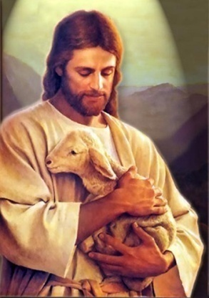
Personal Ministry Credits
Church Life also evaluates:
Faith & work in Church context
Ministry in community – serving outsiders (upliftment & evangelism)
Personal; people serving as Jesus would (making disciples)
This way completing the 7 credits code: MPX1-3

Slide 10

Pray, Take Action
Consider the Great Commission task of discipleship before you
Ask for God’s wisdom
Consider your calling to serve
Plan to do leadership training
At a Bible School you may find restoration and new life as you discover what you have in Christ
Now, register and start!
More Web Info: www.clt.org.za

